Slide 1

Tour Price Prediction Model Using Linear Regression
Searching for an appropriate dataset. Eliminating unnecessary columns. Generating flags and categorical columns. Cleansing the data of missing values and NaNs. Replacing missing entries with zeros. Utilizing filters for data processing.

Slide 2

Introduction Project Goal: To develop a model for predicting the total cost of a tour based on various factors such as tour duration, season, hotel rating, room category, number of tourists, and more. This model will use linear regression to predict tour costs, helping travel agencies and operators to more accurately estimate and set tour prices.
https://github.com/mitiay001/redi_travel.git

Slide 3
Why is this important?:
The travel market is highly competitive, and accurate tour price estimation is crucial for attracting customers and increasing profits.
Travel agencies and operators need to understand which factors influence tour prices in order to optimize their offerings.
Predicting tour prices helps agencies adjust pricing strategies and predict profitability in advance.

Slide 4
2. Data Description The model is built using tour data that includes information on the following parameters: Tour Duration: The number of days tourists spend on the trip. Season: The time of year the tour takes place (e.g., summer, winter, high season, or low season). Hotel Rating: The rating of the hotel on a travel platform. Room Category: The type of room at the hotel (e.g., standard, suite). Number of Tourists: The number of people in the group. Additional Service Costs: Extra expenses such as excursions, meals, etc. Transportation Costs: Transfer and airfare costs. Geographic Features: The destination country and region. This data is presented in a table format with both numerical and categorical features.

Slide 5
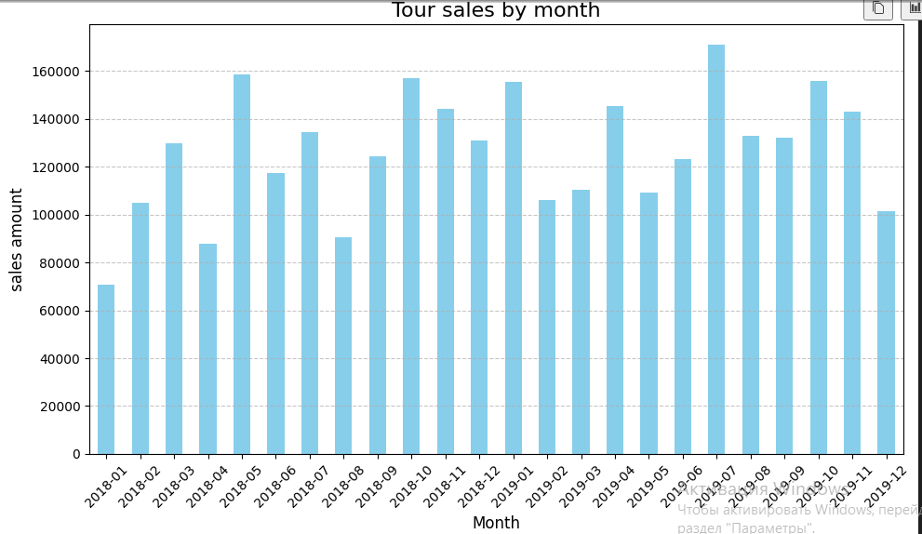
5. Visualisation

Slide 6
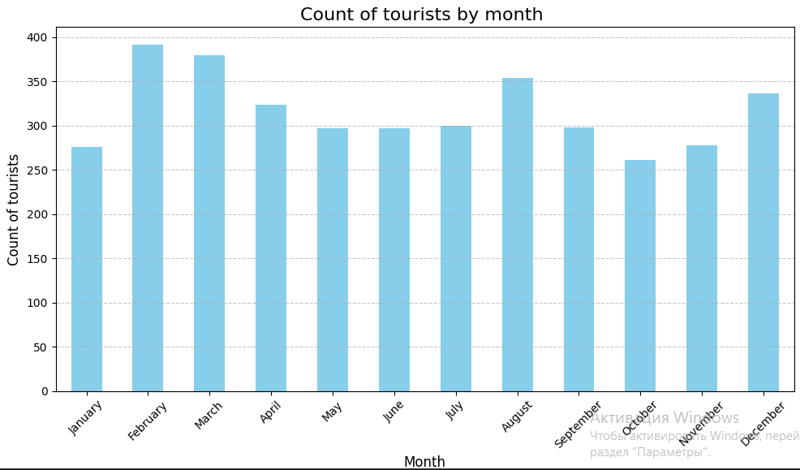
3. Linear Regression Method Description Linear regression is a method that allows us to predict a dependent variable (tour price) based on one or more independent variables (factors such as tour duration, season, number of tourists, etc.). Main Idea: The linear regression model attempts to find coefficients that minimize the prediction error based on the training data. The formula for predicting the tour price will look like this: Tour Price=b0+b1×Duration+b2×Season+b3×Hotel Rating… Where: b0​ - is the intercept, b1,b2,b3,… -are the coefficients for each feature that determine its contribution to the overall price.

Slide 7
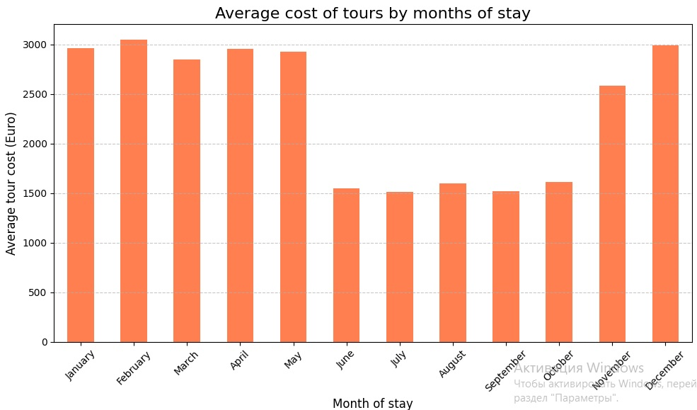
3. Linear Regression Method Description Linear regression is a method that allows us to predict a dependent variable (tour price) based on one or more independent variables (factors such as tour duration, season, number of tourists, etc.). Main Idea: The linear regression model attempts to find coefficients that minimize the prediction error based on the training data. The formula for predicting the tour price will look like this: Tour Price=b0+b1×Duration+b2×Season+b3×Hotel Rating… Where: b0​ - is the intercept, b1,b2,b3,… -are the coefficients for each feature that determine its contribution to the overall price.

Slide 8
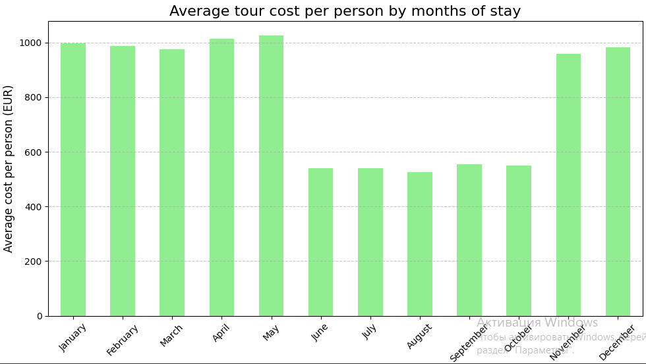
3. Linear Regression Method Description Linear regression is a method that allows us to predict a dependent variable (tour price) based on one or more independent variables (factors such as tour duration, season, number of tourists, etc.). Main Idea: The linear regression model attempts to find coefficients that minimize the prediction error based on the training data. The formula for predicting the tour price will look like this: Tour Price=b0+b1×Duration+b2×Season+b3×Hotel Rating… Where: b0​ - is the intercept, b1,b2,b3,… -are the coefficients for each feature that determine its contribution to the overall price.

Slide 9
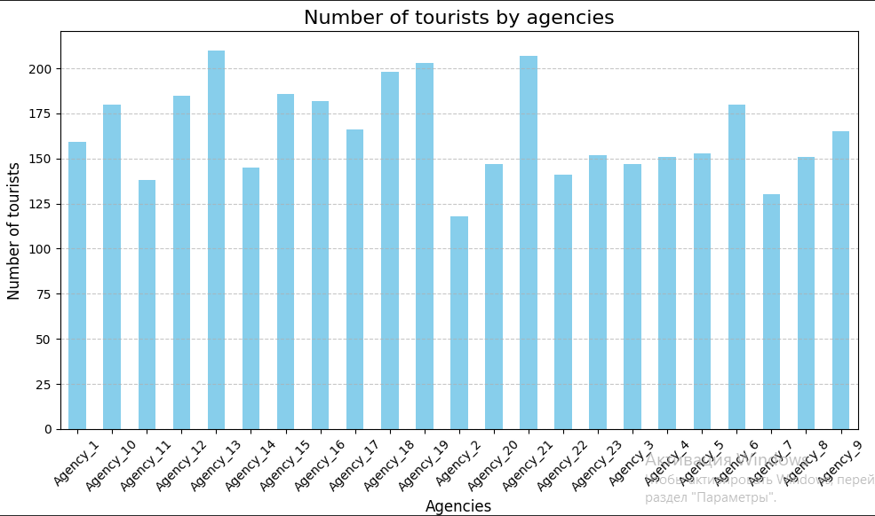
3. Linear Regression Method Description Linear regression is a method that allows us to predict a dependent variable (tour price) based on one or more independent variables (factors such as tour duration, season, number of tourists, etc.). Main Idea: The linear regression model attempts to find coefficients that minimize the prediction error based on the training data. The formula for predicting the tour price will look like this: Tour Price=b0+b1×Duration+b2×Season+b3×Hotel Rating… Where: b0​ - is the intercept, b1,b2,b3,… -are the coefficients for each feature that determine its contribution to the overall price.

Slide 10
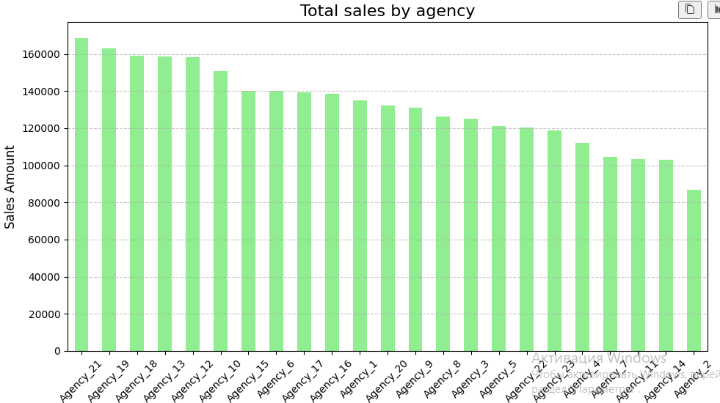
3. Linear Regression Method Description Linear regression is a method that allows us to predict a dependent variable (tour price) based on one or more independent variables (factors such as tour duration, season, number of tourists, etc.). Main Idea: The linear regression model attempts to find coefficients that minimize the prediction error based on the training data. The formula for predicting the tour price will look like this: Tour Price=b0+b1×Duration+b2×Season+b3×Hotel Rating… Where: b0​ - is the intercept, b1,b2,b3,… -are the coefficients for each feature that determine its contribution to the overall price.

Slide 11
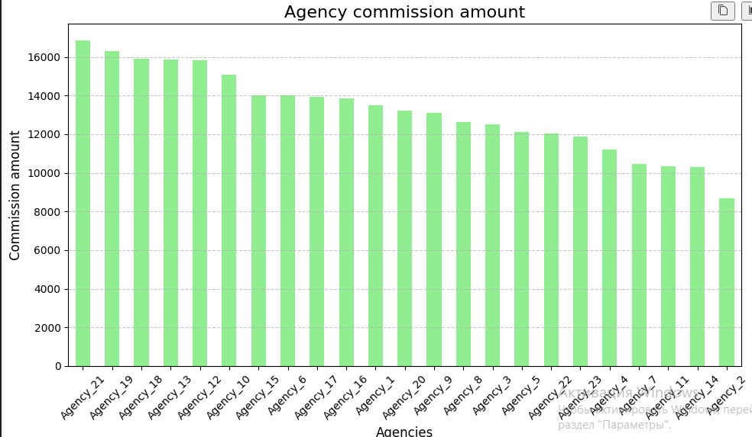
3. Linear Regression Method Description Linear regression is a method that allows us to predict a dependent variable (tour price) based on one or more independent variables (factors such as tour duration, season, number of tourists, etc.). Main Idea: The linear regression model attempts to find coefficients that minimize the prediction error based on the training data. The formula for predicting the tour price will look like this: Tour Price=b0+b1×Duration+b2×Season+b3×Hotel Rating… Where: b0​ - is the intercept, b1,b2,b3,… -are the coefficients for each feature that determine its contribution to the overall price.

Slide 12
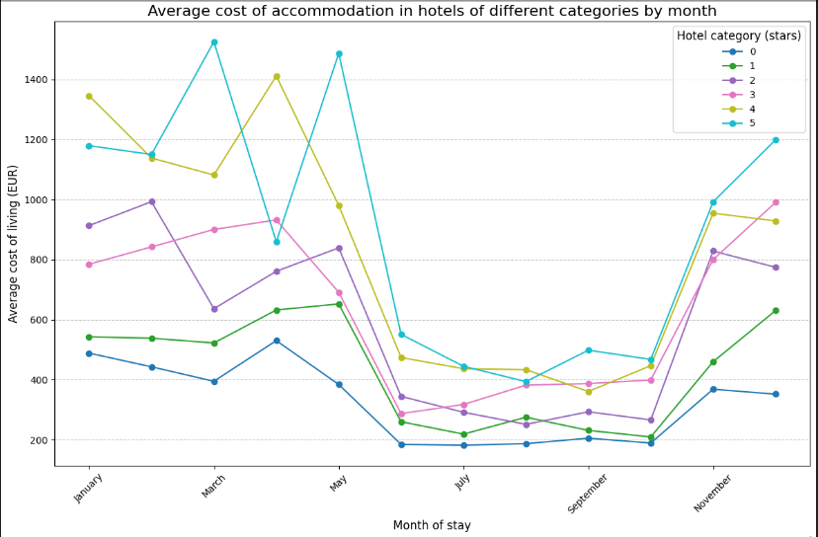
3. Linear Regression Method Description Linear regression is a method that allows us to predict a dependent variable (tour price) based on one or more independent variables (factors such as tour duration, season, number of tourists, etc.). Main Idea: The linear regression model attempts to find coefficients that minimize the prediction error based on the training data. The formula for predicting the tour price will look like this: Tour Price=b0+b1×Duration+b2×Season+b3×Hotel Rating… Where: b0​ - is the intercept, b1,b2,b3,… -are the coefficients for each feature that determine its contribution to the overall price.

Slide 13
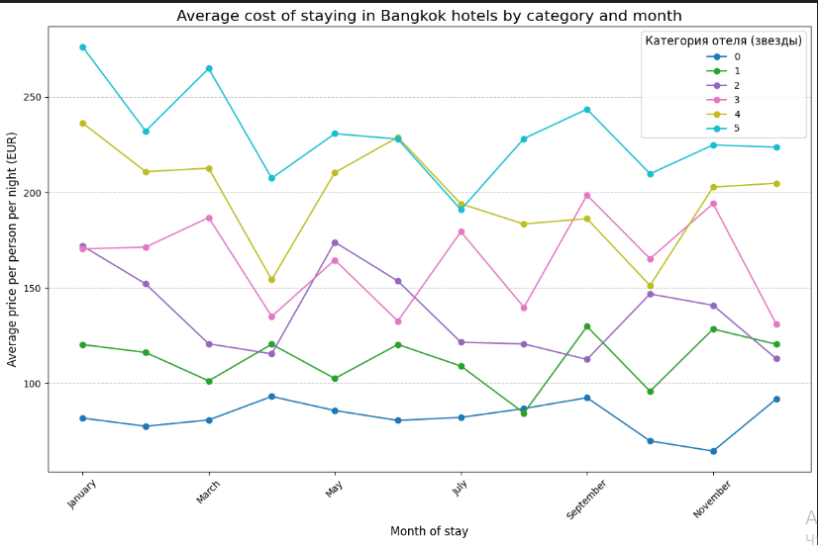
3. Linear Regression Method Description Linear regression is a method that allows us to predict a dependent variable (tour price) based on one or more independent variables (factors such as tour duration, season, number of tourists, etc.). Main Idea: The linear regression model attempts to find coefficients that minimize the prediction error based on the training data. The formula for predicting the tour price will look like this: Tour Price=b0+b1×Duration+b2×Season+b3×Hotel Rating… Where: b0​ - is the intercept, b1,b2,b3,… -are the coefficients for each feature that determine its contribution to the overall price.

Slide 14
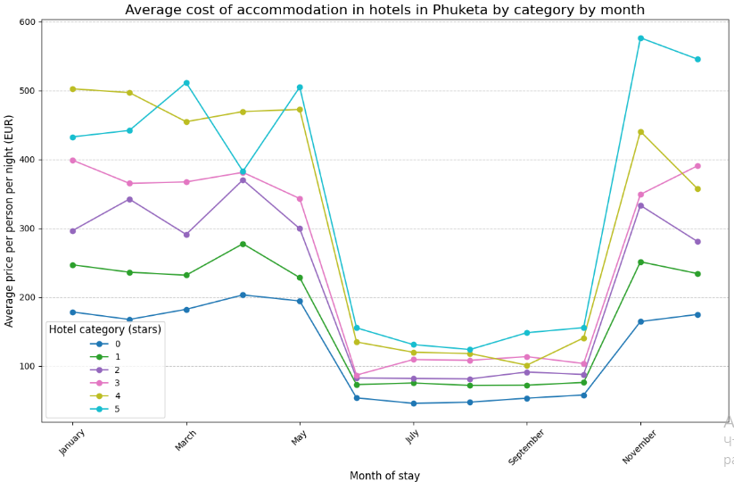
3. Linear Regression Method Description Linear regression is a method that allows us to predict a dependent variable (tour price) based on one or more independent variables (factors such as tour duration, season, number of tourists, etc.). Main Idea: The linear regression model attempts to find coefficients that minimize the prediction error based on the training data. The formula for predicting the tour price will look like this: Tour Price=b0+b1×Duration+b2×Season+b3×Hotel Rating… Where: b0​ - is the intercept, b1,b2,b3,… -are the coefficients for each feature that determine its contribution to the overall price.

Slide 15
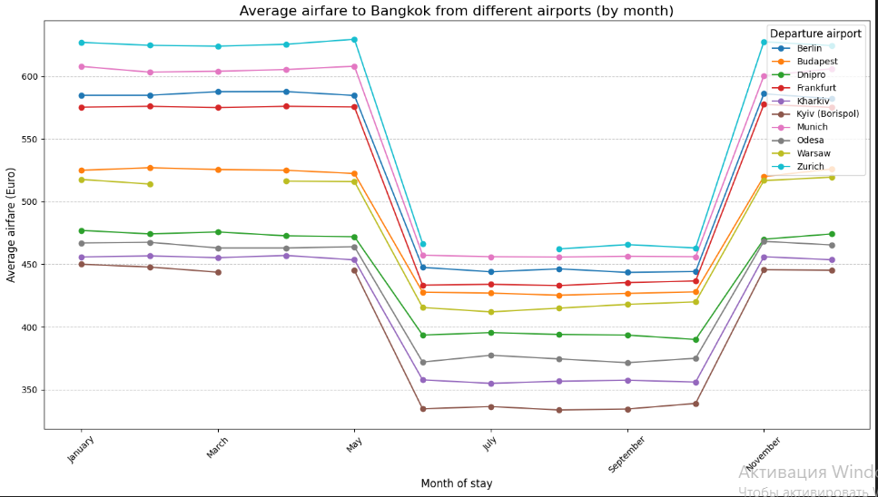
3. Linear Regression Method Description Linear regression is a method that allows us to predict a dependent variable (tour price) based on one or more independent variables (factors such as tour duration, season, number of tourists, etc.). Main Idea: The linear regression model attempts to find coefficients that minimize the prediction error based on the training data. The formula for predicting the tour price will look like this: Tour Price=b0+b1×Duration+b2×Season+b3×Hotel Rating… Where: b0​ - is the intercept, b1,b2,b3,… -are the coefficients for each feature that determine its contribution to the overall price.

Slide 16
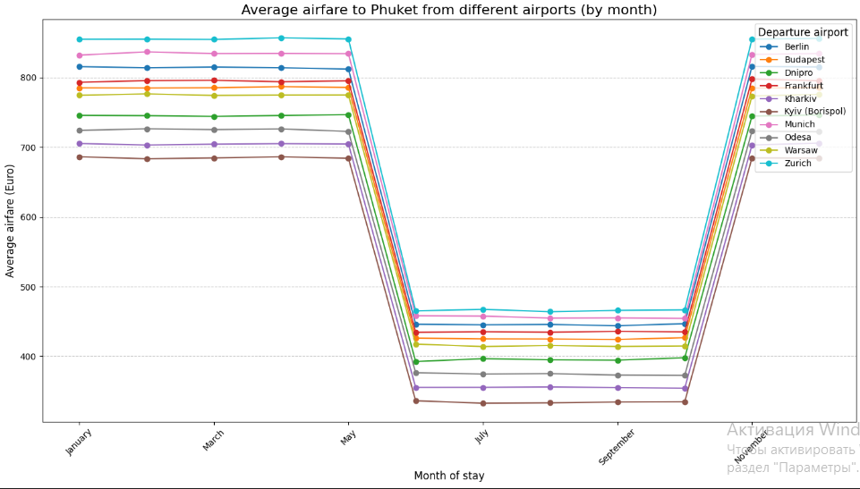
3. Linear Regression Method Description Linear regression is a method that allows us to predict a dependent variable (tour price) based on one or more independent variables (factors such as tour duration, season, number of tourists, etc.). Main Idea: The linear regression model attempts to find coefficients that minimize the prediction error based on the training data. The formula for predicting the tour price will look like this: Tour Price=b0+b1×Duration+b2×Season+b3×Hotel Rating… Where: b0​ - is the intercept, b1,b2,b3,… -are the coefficients for each feature that determine its contribution to the overall price.

Slide 17
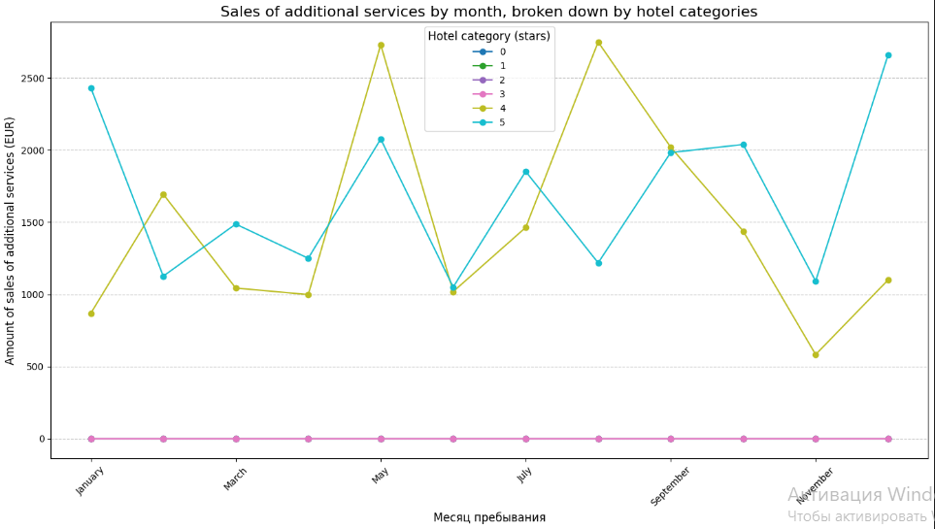
3. Linear Regression Method Description Linear regression is a method that allows us to predict a dependent variable (tour price) based on one or more independent variables (factors such as tour duration, season, number of tourists, etc.). Main Idea: The linear regression model attempts to find coefficients that minimize the prediction error based on the training data. The formula for predicting the tour price will look like this: Tour Price=b0+b1×Duration+b2×Season+b3×Hotel Rating… Where: b0​ - is the intercept, b1,b2,b3,… -are the coefficients for each feature that determine its contribution to the overall price.

Slide 18
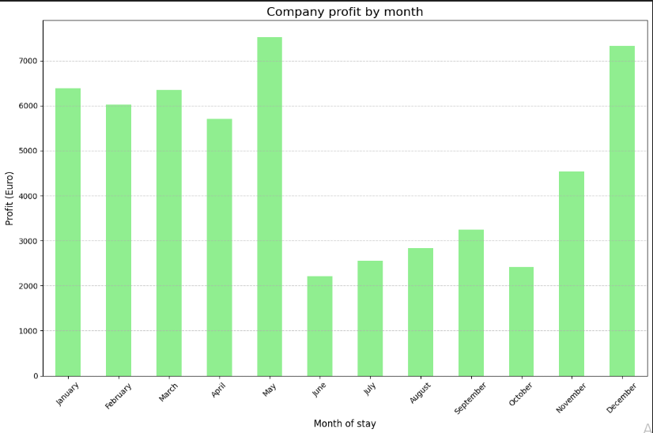
3. Linear Regression Method Description Linear regression is a method that allows us to predict a dependent variable (tour price) based on one or more independent variables (factors such as tour duration, season, number of tourists, etc.). Main Idea: The linear regression model attempts to find coefficients that minimize the prediction error based on the training data. The formula for predicting the tour price will look like this: Tour Price=b0+b1×Duration+b2×Season+b3×Hotel Rating… Where: b0​ - is the intercept, b1,b2,b3,… -are the coefficients for each feature that determine its contribution to the overall price.

Slide 19
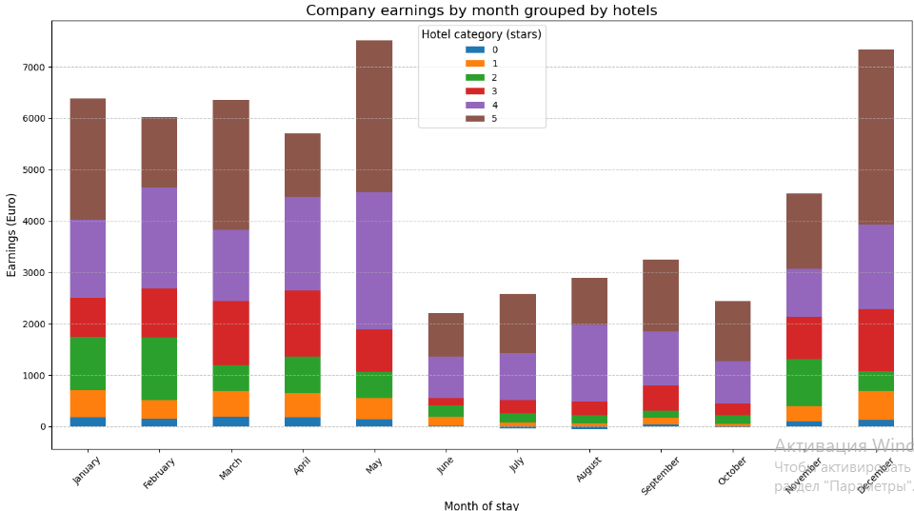
3. Linear Regression Method Description Linear regression is a method that allows us to predict a dependent variable (tour price) based on one or more independent variables (factors such as tour duration, season, number of tourists, etc.). Main Idea: The linear regression model attempts to find coefficients that minimize the prediction error based on the training data. The formula for predicting the tour price will look like this: Tour Price=b0+b1×Duration+b2×Season+b3×Hotel Rating… Where: b0​ - is the intercept, b1,b2,b3,… -are the coefficients for each feature that determine its contribution to the overall price.

Slide 20
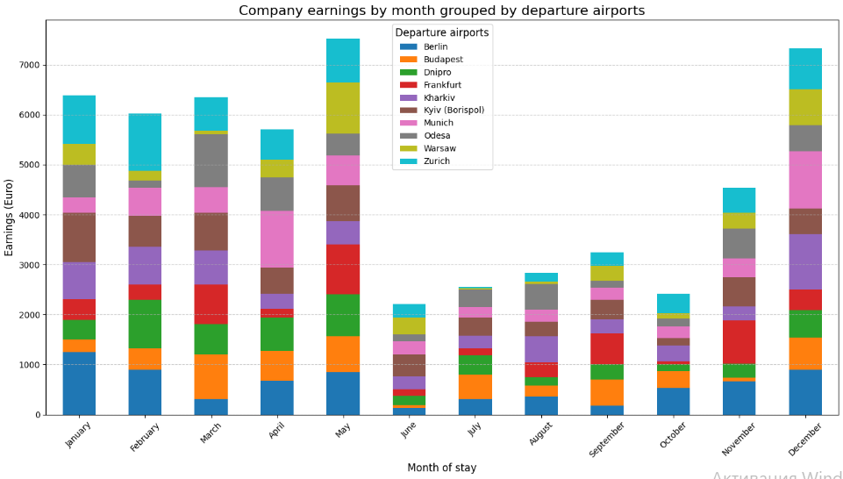
3. Linear Regression Method Description Linear regression is a method that allows us to predict a dependent variable (tour price) based on one or more independent variables (factors such as tour duration, season, number of tourists, etc.). Main Idea: The linear regression model attempts to find coefficients that minimize the prediction error based on the training data. The formula for predicting the tour price will look like this: Tour Price=b0+b1×Duration+b2×Season+b3×Hotel Rating… Where: b0​ - is the intercept, b1,b2,b3,… -are the coefficients for each feature that determine its contribution to the overall price.

Slide 21
3. Linear Regression Method Description Linear regression is a method that allows us to predict a dependent variable (tour price) based on one or more independent variables (factors such as tour duration, season, number of tourists, etc.). Main Idea: The linear regression model attempts to find coefficients that minimize the prediction error based on the training data.

Slide 22
4. Project Implementation Stages Data Preprocessing: - Data cleaning: handling missing values and errors. - Converting categorical features into numerical ones using encoding (e.g., One-Hot Encoding for features like season). - Normalization/standardization of data to improve model performance. Splitting Data into Training and Test Sets: - The training set is used to build the model. - The test set helps evaluate the model's performance. Building the Linear Regression Model: Using the scikit-learn library to create the model.

Slide 23
4. Project Implementation Stages Data Preprocessing: - Data cleaning: handling missing values and errors. - Converting categorical features into numerical ones using encoding (e.g., One-Hot Encoding for features like season). - Normalization/standardization of data to improve model performance. Splitting Data into Training and Test Sets: - The training set is used to build the model. - The test set helps evaluate the model's performance. Building the Linear Regression Model: Using the scikit-learn library to create the model.

Slide 24
4. Project Implementation Stages Data Preprocessing: - Data cleaning: handling missing values and errors. - Converting categorical features into numerical ones using encoding (e.g., One-Hot Encoding for features like season). - Normalization/standardization of data to improve model performance. Splitting Data into Training and Test Sets: - The training set is used to build the model. - The test set helps evaluate the model's performance. Building the Linear Regression Model: Using the scikit-learn library to create the model.

Slide 25
Thank you all for your attention and understanding! Have a good evening!

